Slide 1

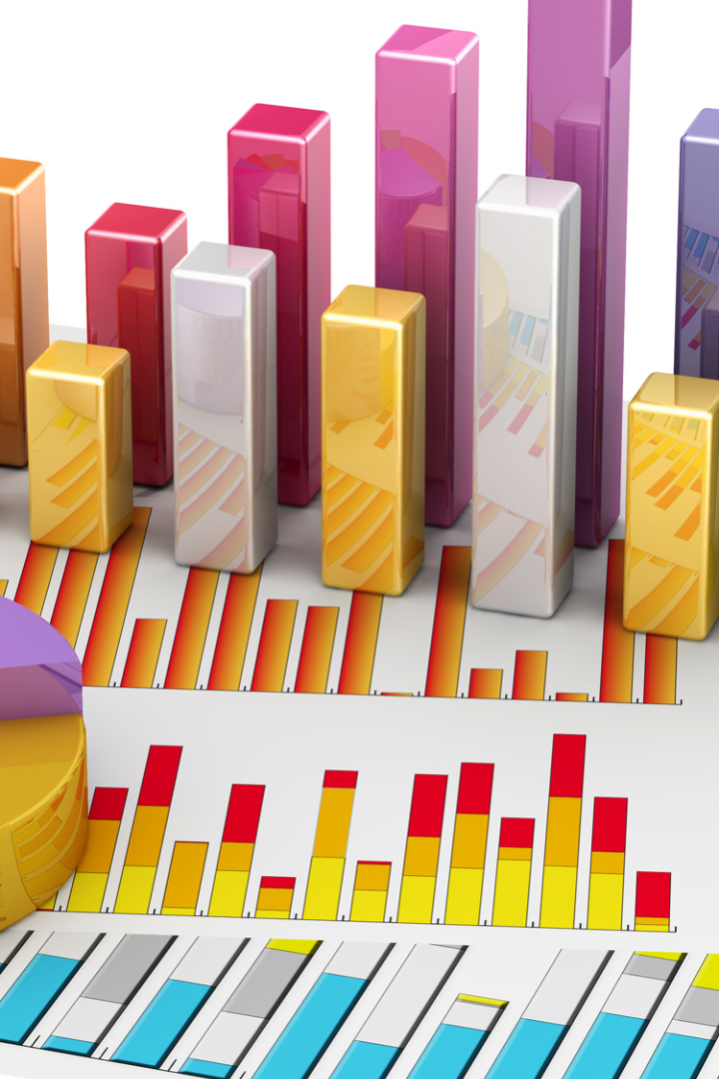

Measure of Tendency
Explore the fascinating world of measure of tendency. Discover the various methods and techniques to analyze and interpret data effectively.

Slide 2

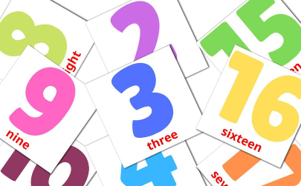
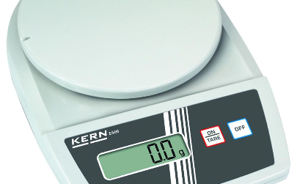
Mean: The Average
Definition
Calculation
Application
The mean is calculated by summing up all the values in a dataset and dividing it by the total number of values.
Add all the values and divide the sum by the number of values in the dataset.
The mean is commonly used in classifying and comparing different numerical datasets.

Slide 3

Median: The Middle Value
1
Definition
2
Determining the Median
The median is the middle value in a dataset when the values are arranged in ascending or descending order.
If there is an odd number of values, the median is the middle value. If there is an even number of values, the median is the average of the two middle values.
3
Usage
The median is often used when dealing with skewed data or outliers.

Slide 4

Mode: The Most Frequent Value
Definition
Finding the Mode
Significance
The mode is the value that appears most frequently in a dataset.
Identify the value that occurs with the highest frequency in the dataset.
The mode is useful for identifying the most typical value or category in a dataset.

Slide 5

Range: The Spread of Data
1
Definition
The range is the difference between the maximum and minimum values in a dataset.
2
Calculation
Subtract the minimum value from the maximum value.
3
Interpretation
A larger range indicates a wider spread of data, while a smaller range suggests a narrower distribution.

Slide 6
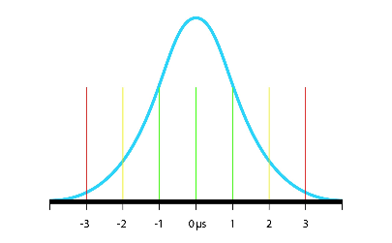
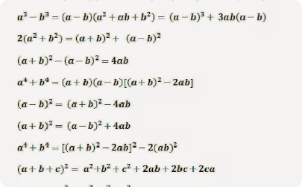

Standard Deviation: The Dispersion of Data
Definition
Calculation
Importance
The standard deviation measures how spread out the values in a dataset are around the mean.
The standard deviation is calculated as the square root of the variance.
A higher standard deviation indicates a greater dispersion of data, while a lower standard deviation suggests a more clustered dataset.

Slide 7

Interquartile Range: The Middle Spread
1
Definition
2
Calculation
The interquartile range is the difference between the third quartile (75th percentile) and the first quartile (25th percentile).
Identify the values that correspond to the 25th and 75th percentiles, and subtract the first quartile from the third quartile.
3
Usage
The interquartile range is often used to measure the spread of data while ignoring outliers.

Slide 8
Percentile: Relative Position
1
Definition
Percentiles represent a specific position in a dataset, indicating the value below which a certain percentage of data falls.
Calculation
2
Determine the value below which a specific percentage of data falls, arranging the dataset in ascending or descending order.
3
Application
Percentiles are useful for comparing individual data points to the overall dataset and evaluating performance based on relative position.

